Slide 1
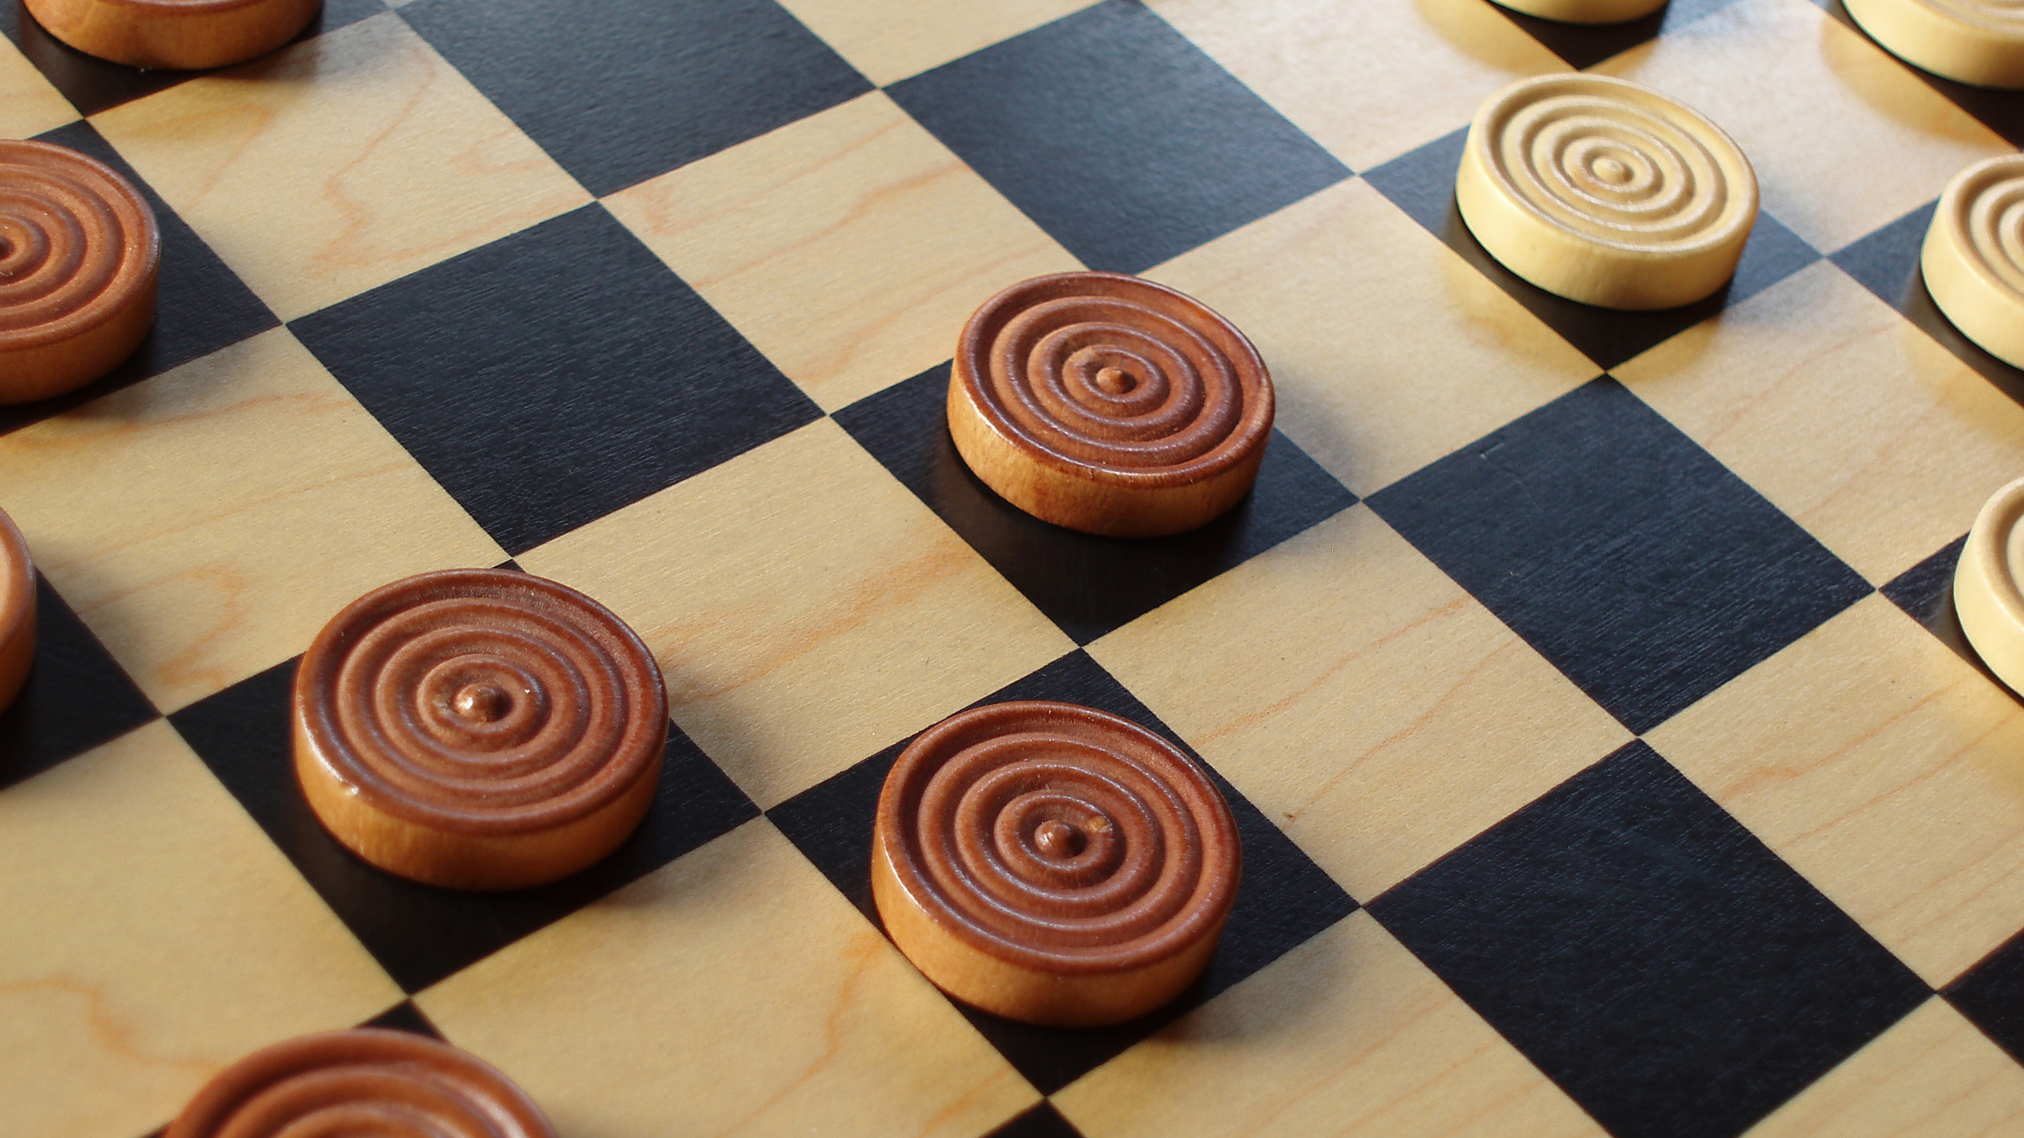
Checkers AI
David Cowan
CS 7375: Artificial Intelligence
This Photo by Unknown Author is licensed under CC BY

Slide 2
Environment and Tools
Environments:
Jupyter Notebook
Visual Studio Code
Language:
Python
Packages:
Tensorflow
Numpy
Pandas
Random
Imapaai-checker

Slide 3
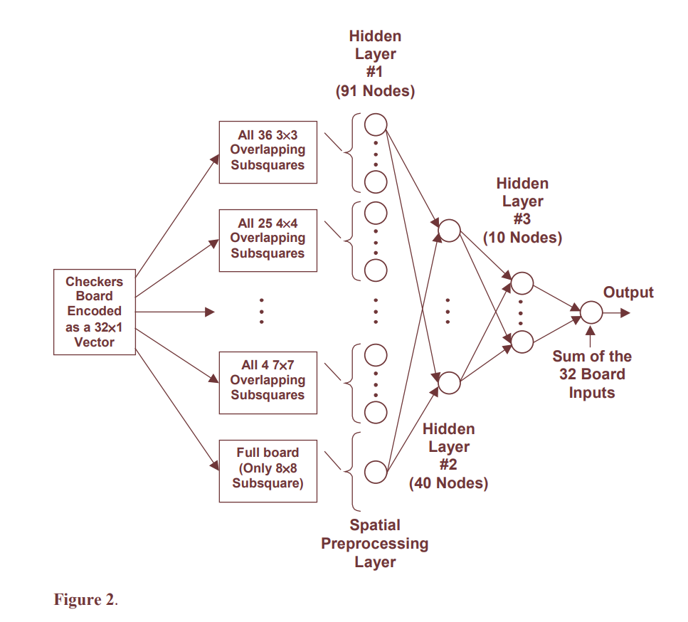
Blondie24
Developed by David Fogel and Kumar Chellapilla in 1999
15 parents per generation, each generating 1 offspring
Each played 5 games: -2 pt (L), 0 pt (D), 1 pt (W), top 15 moved on to next generation
Used minimax alpha-beta search with neural network as evaluation function to pick best move
Completed 840 generations and then best played human opponents on The Zone website
After 165 games, it achieved rating of 2048 (top 1% on the website)

Slide 4
Methology
Use a CNN to predict the best move out of a set of board. This will be how the AI know what move to make
Weights for CNN will be trained by a Genetic Algorithm using Reinforcement Learning
Best Weights from a generation will be used to create next generation of weights
Each generation starts with 1028 weight set and selects best 16 weight sets

Slide 5
CNN Architecture
4 Layer CNN, sigmoid activation function
2 Convolutional Layers:
3, 5x5 filters
3, 3x3 filters
Flatten
2 Fully Connected Layers
6 Nodes
1 Node
Input is 8x8 board:
0-blank, 1 regular pieces, 2 kings
+ self, - opponent
Output: Score for the board
Idea: Input all possible boards, pick move that leads to board with highest score
Model: "model"
________________________________________________
Layer (type) Output Shape Param #
====================================conv2d (Conv2D) (None, 4, 4, 3) 78
conv2d (Conv2D) (None, 2, 2, 3) 84
flatten (Flatten) (None, 12) 0
dense (Dense) (None, 6) 78
dense (Dense) (None, 1) 7
====================================
Total params: 247
Trainable params: 247
Non-trainable params: 0
________________________________________________

Slide 6
Selection
Started with 1028 weight set
3 Rounds of Head-to-Head
Winner advances, loser is removed
128 weight sets at the end
3 Rounds of 4-member Round Robins
Each member plays the other 3 members
Win: 3 points, Tie: 1 point, Loss: 0 points
Top 2 from each group advance, Bottom 2 are removed
16 weigtht sets at end
Optional: 1 Round 16-member Round Robin
Similar to 4-member Round Robin, but only used to rank weight sets

Slide 7
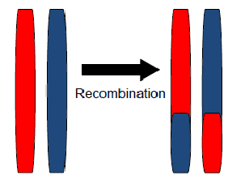
Generation
Start with 16 weight sets
Recombination:
Each combination of weight set is paired up (a & b)
A random number, x, between 1-247 is generated
2 new weights sets are generated from each combination by concatenating a[0,x] with b[x,247] and also b[0,x] with a[x,247]
Results in 240 new weight sets + 16 original = 256 weight set
Mutation:
A random array of 247 values between -0.1 and 0.1 is generated
The random array is added to a weight set to generate a new weight set
Each previous weight set is used to generate 3 new weight sets
Results in 768 new weight sets + 256 previous = 1028 total weight sets

Slide 8
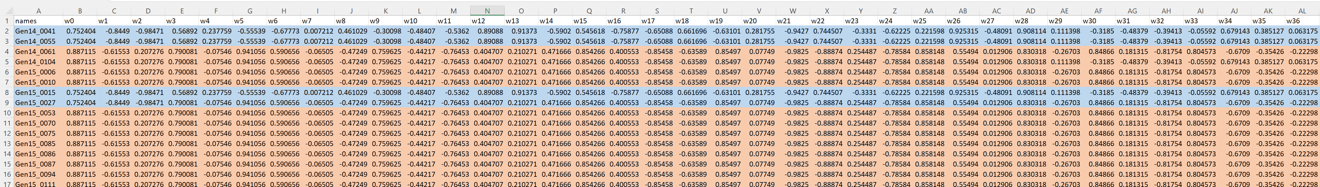
Convergence
Completed 15 Generation
As more generations were done, I noticed model converged into a few models.
Less ‘genetic diversity’ in training
Decided to end training and find the best

Slide 9
Best from Gen15 Results
Names | Points | Wins
Gen15_0111 | 32 | 9
Gen15_0086 | 27 | 6
Gen15_0010 | 19 | 2
Gen15_0085 | 19 | 2
Gen15_0015 | 17 | 1
Gen14_0041 | 16 | 1
Gen14_0055 | 16 | 1
Gen15_0006 | 16 | 1
Gen15_0053 | 16 | 1
Gen15_0087 | 16 | 1
Gen14_0061 | 15 | 1
Gen15_0094 | 15 | 1
Gen15_0075 | 15 | 0
Gen15_0070 | 14 | 0
Gen14_0104 | 9 | 0
Gen15_0027 | 6 | 1
Did Round Robin with best 16 from Generation 15
Gen15_0111 was best and was tested further

Slide 10
Gen15_0111 against other Generations
Generation | First Move | Record (Win-Draw-Loss)
0 | Gen15_0111 | 16-0-0
0 | Gen0 | 16-0-0
5 | Gen15_0111 | 16-0-0
5 | Gen5 | 8-4-4
10 | Gen15_0111 | 16-0-0
10 | Gen10 | 6-6-4
Gen15_0111 was tested against 16 best from Gen0, Gen5, Gen10
Gen15_0111 undefeated when it goes first and still does well when it goes second
Shows that the strategy used is able to learn the best move

Slide 11
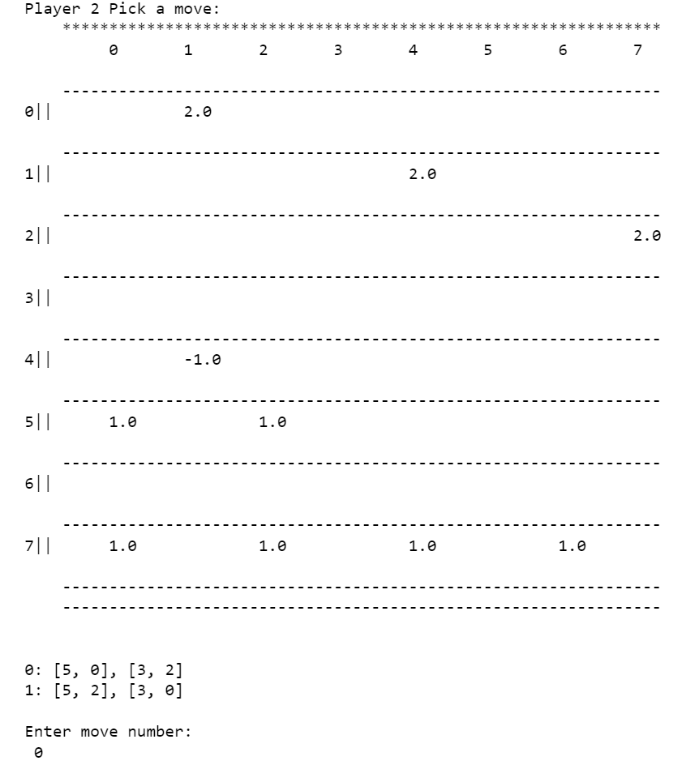
Gen15_0111 Against Human
I can beat it easily
Does ok at start, but later pick moves where I can jump/double jump with better moves on the board

Slide 12
Conclusions and Improvements
This framework resulted in better individuals over successive generations
Use minimax search to pick move with CNN as evaluation function
More complex model (Mine: 247 weights, 4 layers; Blondie24: 5046 weights, 3 layers)
Use an endgame database to pick optimal moves for a win

Slide 13

Questions

